Slide 1


Philip Nelson and Brigham Michaelis

Slide 2
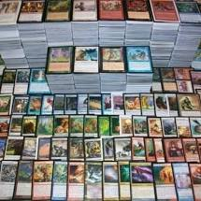
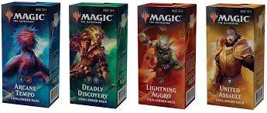
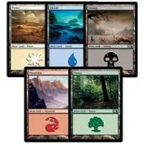
Super basic rules and introduction
Create a deck from the available 20,000 cards. Or use a prefab deck.
Your deck must be at least 60 cards.
Up to fifteen cards may be included in your sideboard, if you use one.
Include no more than four copies of any individual card in your main deck and sideboard combined (except basic lands).
There's no maximum deck size, as long as you can shuffle your deck in your hands unassisted.

Slide 3
How to rank a deck
There are currently a number of ways to rank a deck.
Goldfishing
Reporting your deck stats on various websites.
What if we could make a novel deck ranker?
With the amount of data we have available to us, and the skills and knowledge from this class, we think it may be possible to come up with a novel deck ranker (however naive it may be) for Magic the Gathering.

Slide 4
Schedule
Our Schedule: April 12-15: Get data from kaggle, munge and analyze.
April 16-25: Using deck data from kaggle, mtggoldfish, and mtgmeta, devise a novel method to rank a deck.
(This may take several failed attempts)
April 26-30: Write 6 page report.
May 1: Submit project

Slide 5
Potential Problems and Solutions
Potential Problems and Solutions or Alternatives
Our novel deck ranker could suck.
We can mitigate this possibility by attempting and documenting all the approaches we take in creating this novel deck ranker
It may be possible (and slightly easier) to come up with a novel card ranker that isn’t driven by sale price only.
It may be that we could significantly add to the dataset found on Kaggle and end up submitting a new dataset.
Finally if all the previously mentioned attempts fail, with all the data we have available to us, we could ask and answer some very interesting questions with regards to Magic the Gathering.

